Slide 1
Stat 301-2
Presentation
Holland Blumer
Major: Manufacturing and Design Engineering
March 11, 2020

Slide 2


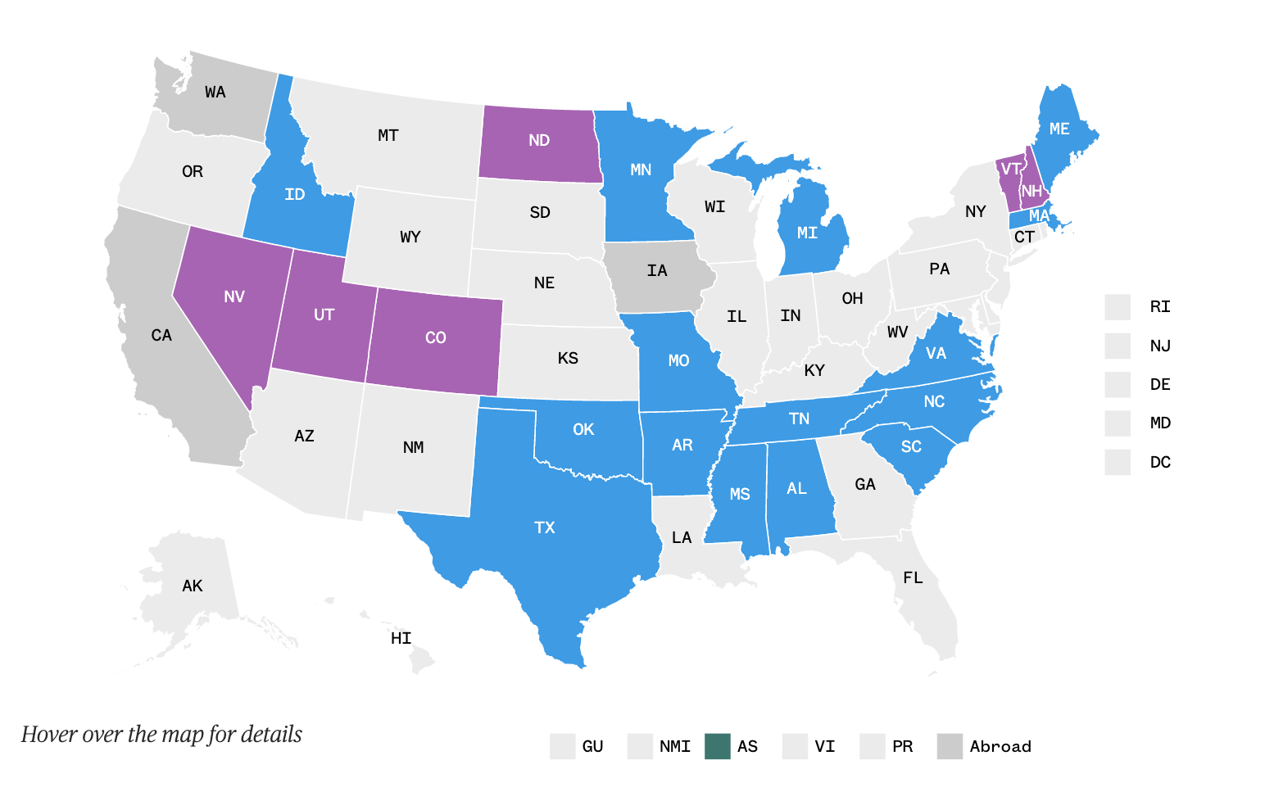
Overview
Election Data

Slide 3



Overview
Donald Trump
Bernie Sanders
Joe Biden

Slide 4
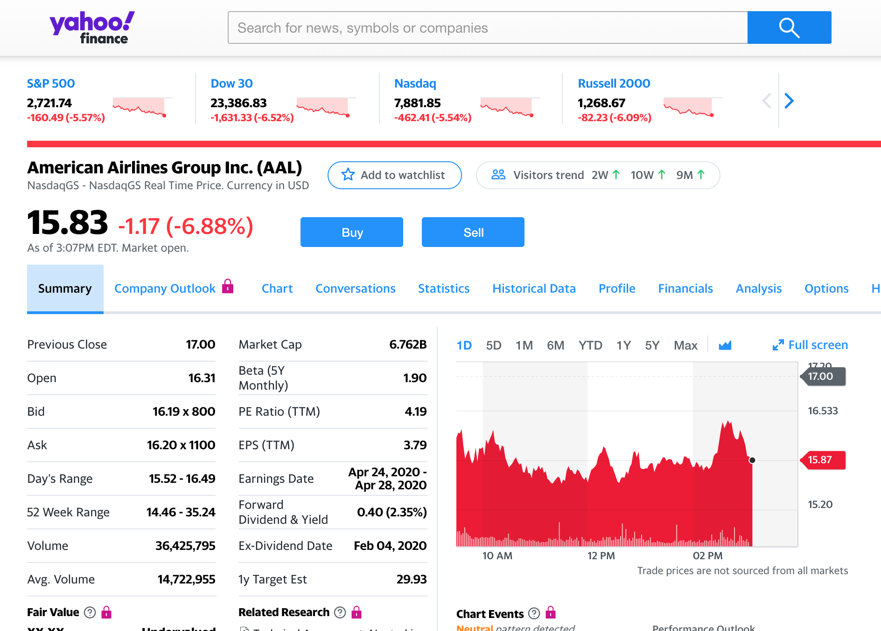
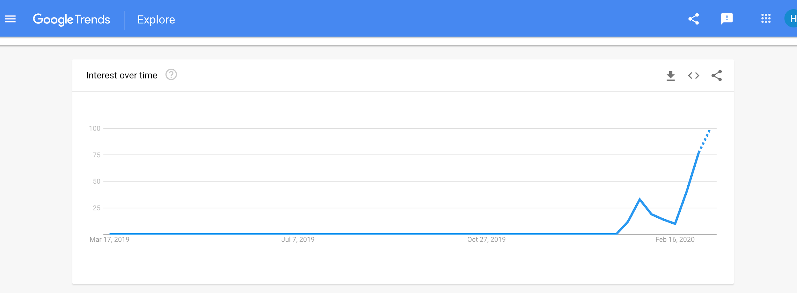
Overview

Slide 5
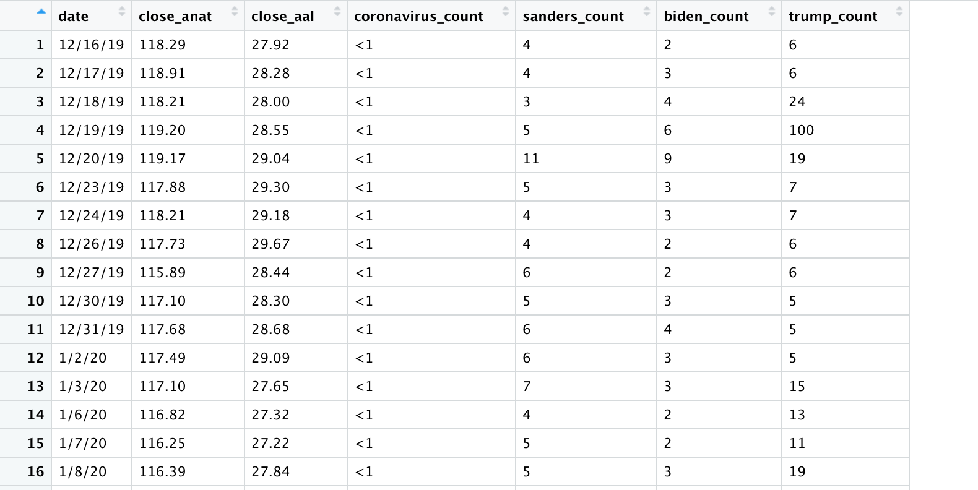
Tidy Data
Overview
EDA
Polynomial
Next Steps

Slide 6
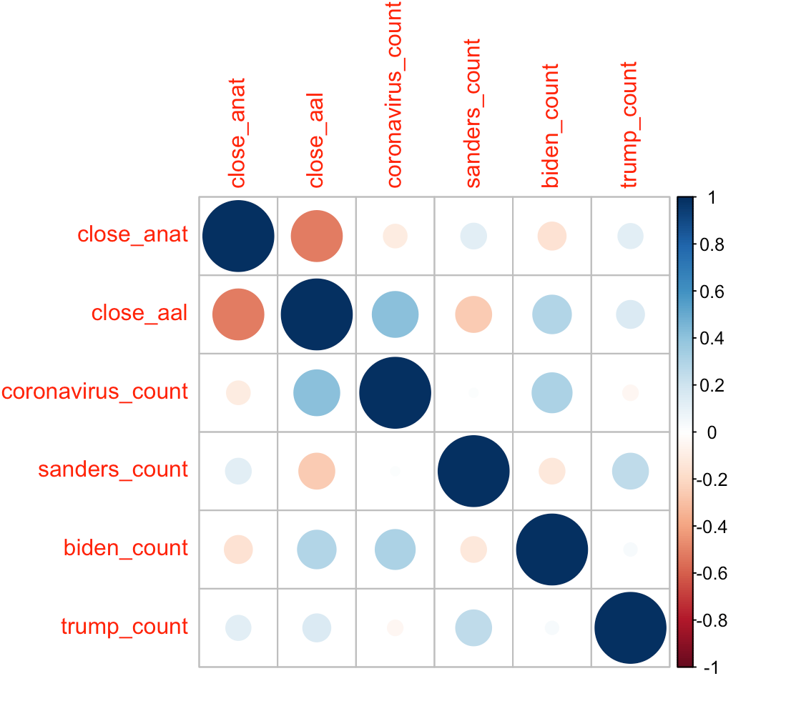
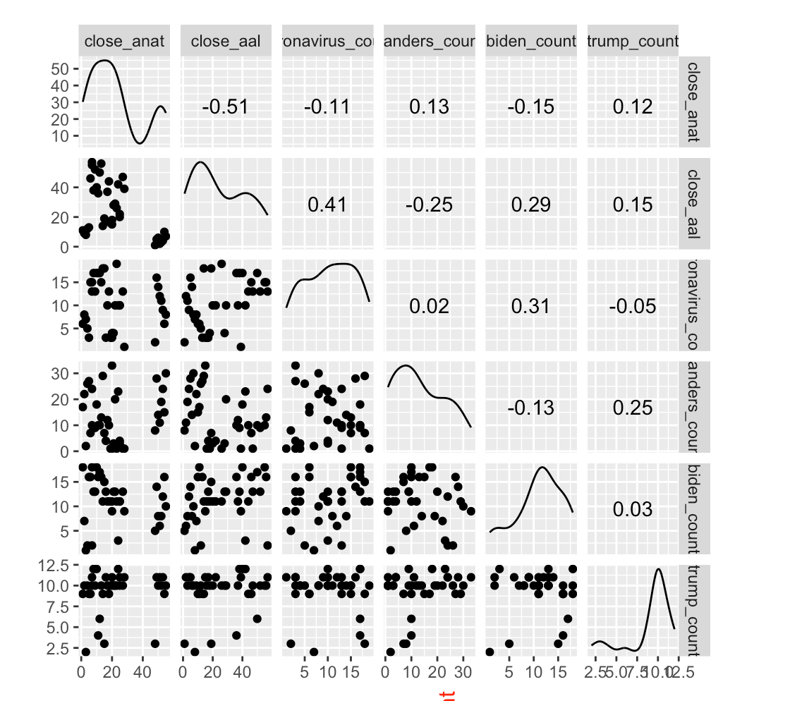
EDA
Overview
EDA
Regression
Next Steps

Slide 7
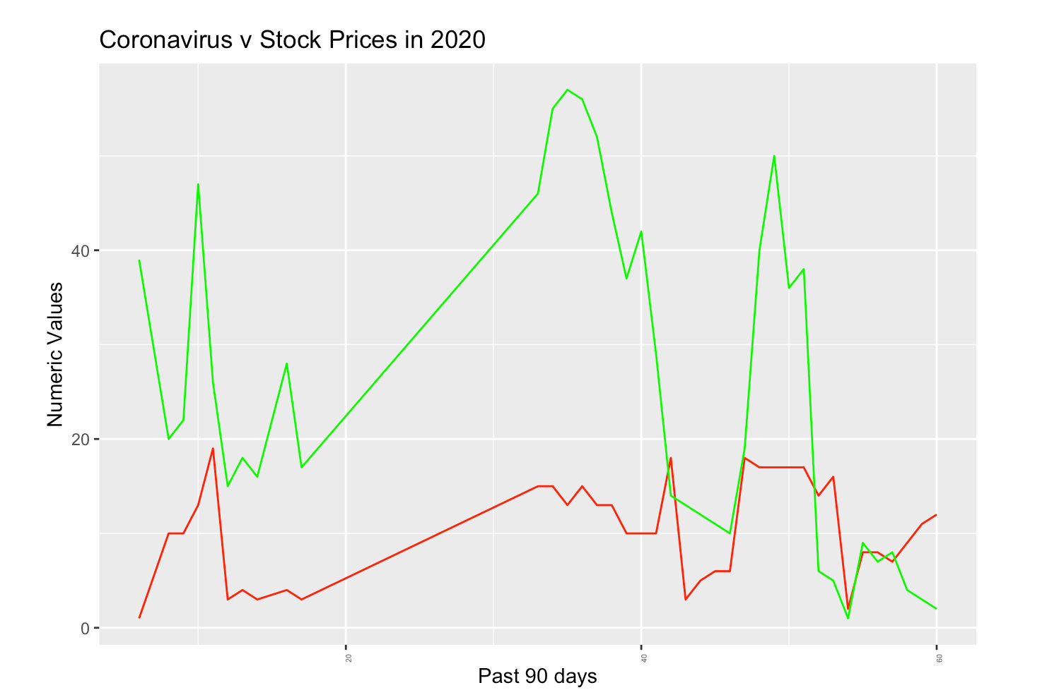
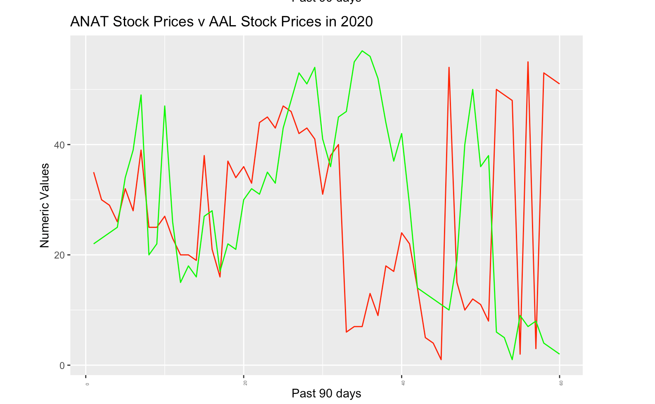
EDA
Overview
EDA
Regression
Next Steps

Slide 8
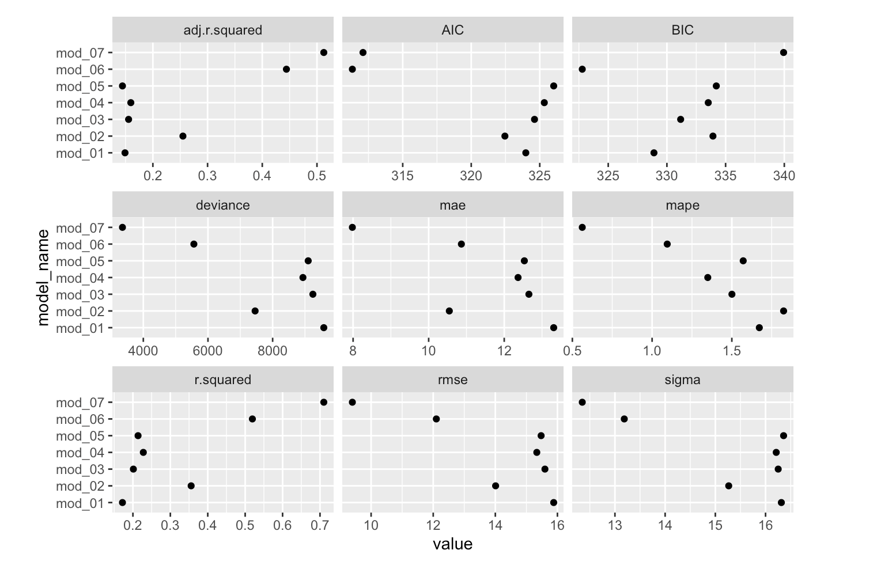
Multiple Linear Regression
Findings
LDA
Regression
Next Steps

Slide 9
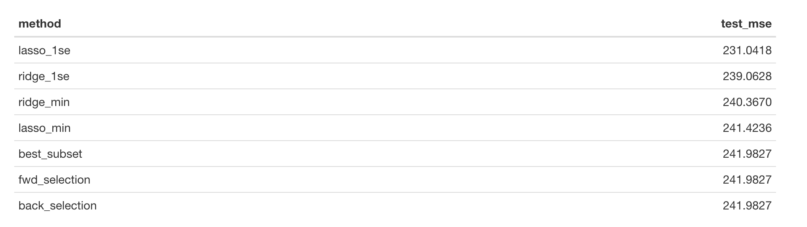
Subset Selection/Ridge/Lasso
Findings
LDA
Regression
Next Steps

Slide 10
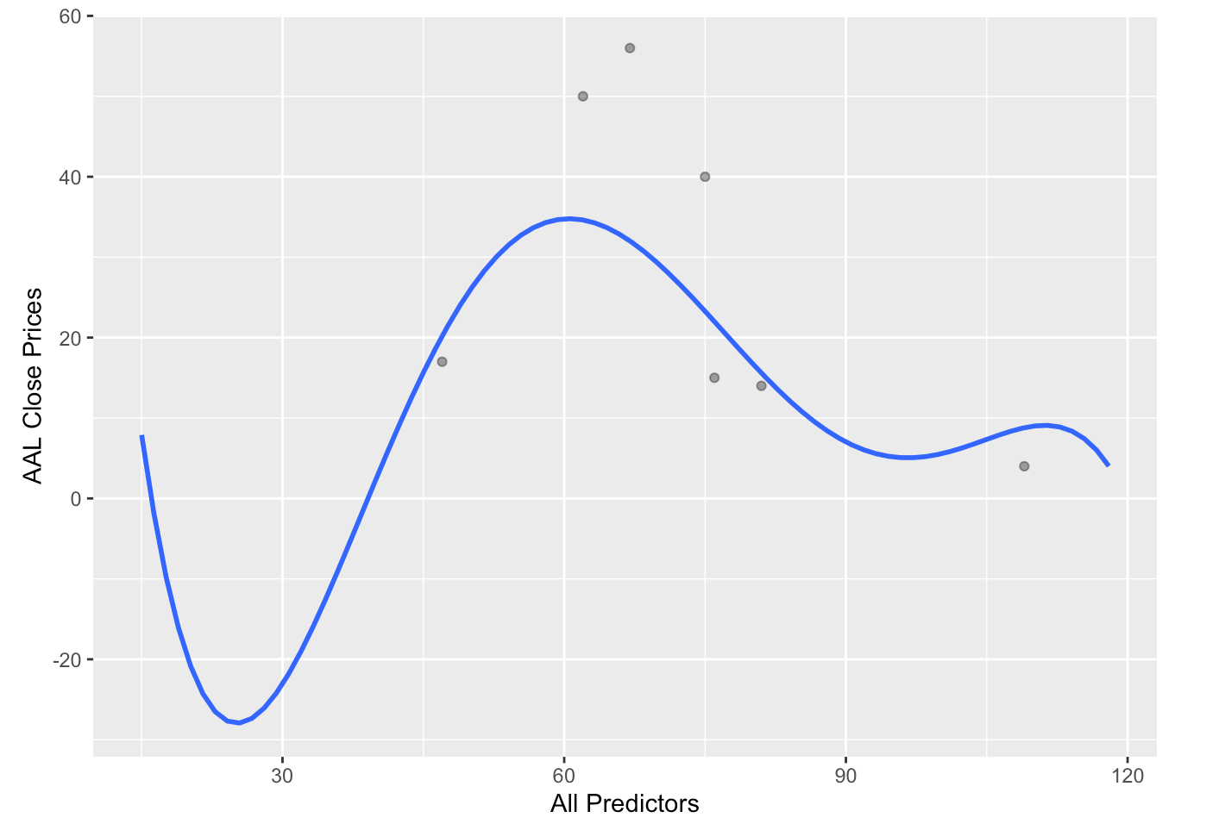
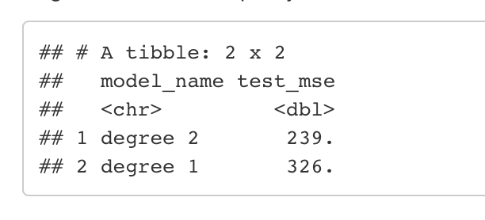
Regression Cont..
Findings
LDA
Regression
Next Steps
Polynomial

Slide 11
Findings
LDA
Polynomial
Next Steps
Next Steps
Increase sample size
Loop through dates & remove rows that don’t match
---
Compare swine flu and AAL data from 2009
Use Yahoo Finance API in R

Slide 12
Findings
LDA
Polynomial
Next Steps
Next Steps
Questions?

